Slide 1
Feed Hunger
Theme: Hack For good

Slide 2
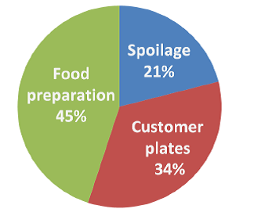
The Harsh Reality
Problems:
1)Lack of food availability
2) poverty and food prices are inextricably linked
3)Wastage of food

Slide 3
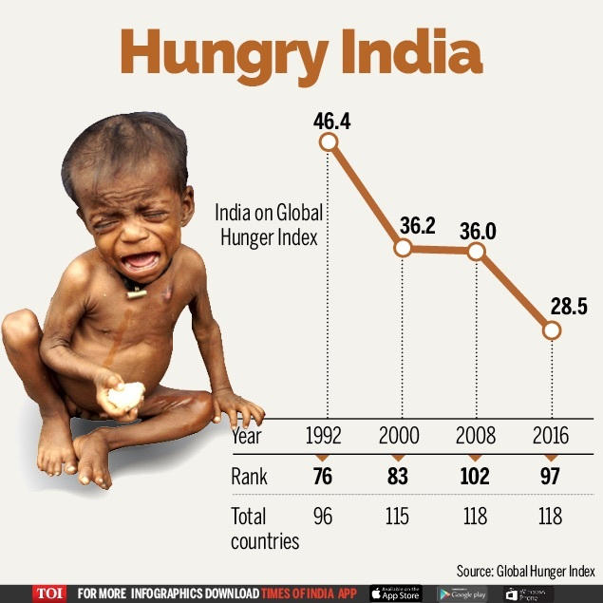
Of the 821 million people suffering from chronic hunger, 98 percent live in the developing world .Unlike famines that receive emergency-aid, chronic hunger is a silent, invisible, day-after-day condition.

Slide 4
Using Technology as a Solution
Donate by user
(From)
Luxurious Parties
Households
Restaurants and canteens
Donate user
(To)
Orphanages
NGO’s
Others
Specify Location
Pickup Boy/self
Delivery Complete

Slide 5


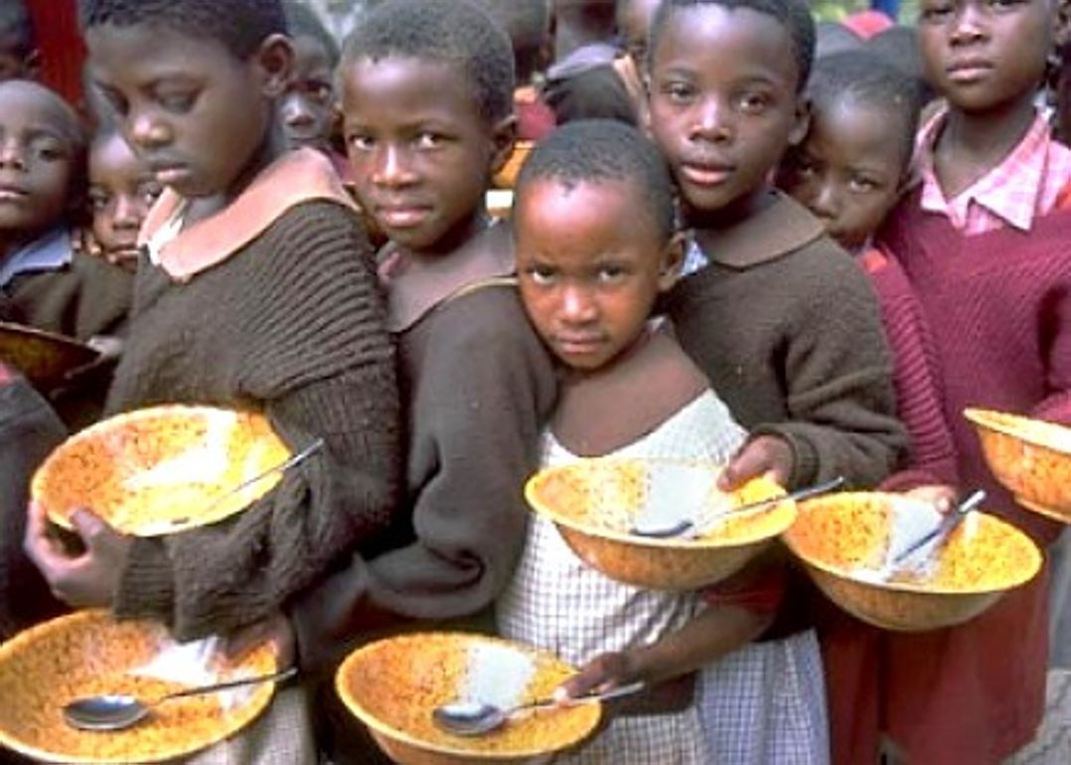
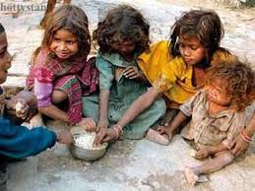
If we all work Together and succeed
Before
After

Slide 6
THANK YOU

